Slide 1
Ggplot2 and interactive graphics with R
Christophe Ladroue
SECTION 03
VIDEO 03
Minimizing overplotting
www.PacktPub.com

Slide 2
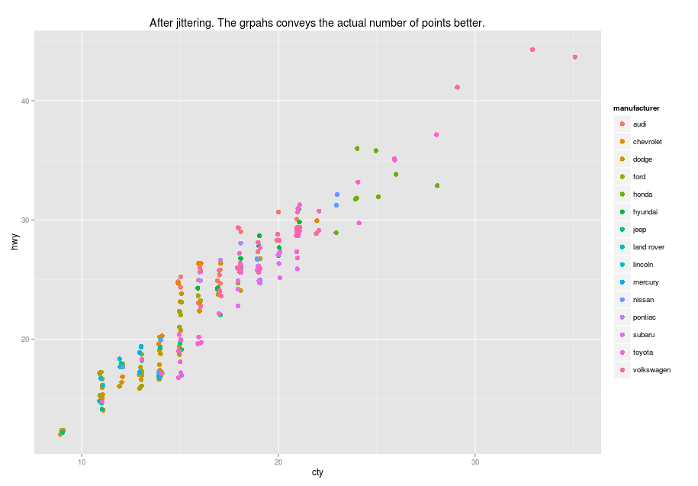
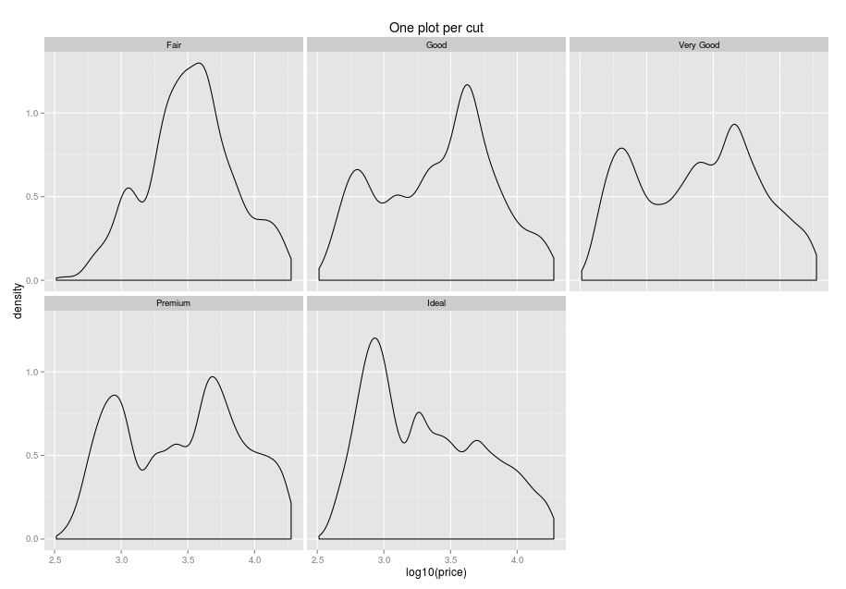
In this video we took a look at
how overplotting can be an issue when many datapoints share the same values.
how to randomly move the data about to avoid overplotting.
Next: plotting subsets of data

